Slide 1
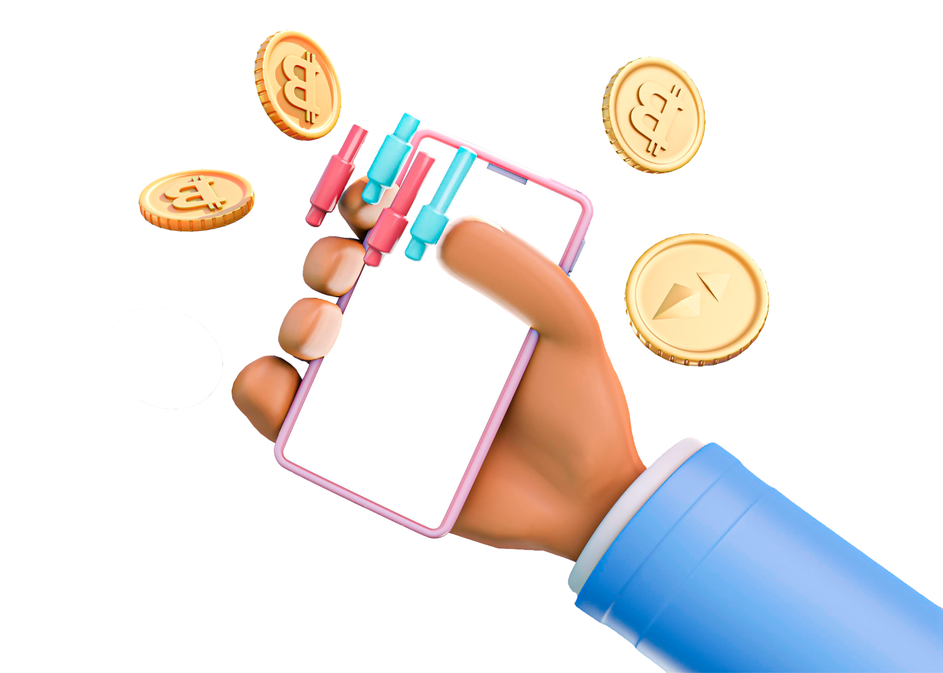

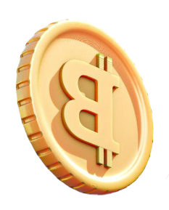
NFT Minter using Ethereum Blockchain
BRANCH: - ‘CS-C’ | BATCH: - ‘B1’ | GROUP: - ‘48’

Slide 2
WHAT ARE NFTs??
Non-fungible tokens (NFTs) are cryptographic assets on a blockchain with unique identification codes and metadata that distinguish them from each other.
Unlike cryptocurrencies, they cannot be traded or exchanged at equivalency.
This differs from fungible tokens like cryptocurrencies, which are identical to each other and, therefore, can serve as a medium for commercial transactions.
NFTs can represent real-world items like artwork and real estate.
"Tokenizing" these real-world tangible assets makes buying, selling, and trading them more efficient while reducing the probability of fraud.
NFTs can also function to represent individuals' identities, property rights, and more.
It’s a medium for commercial transactions.

Slide 3

WHAT IS NFT MINTING??
Minting an NFT, or non-fungible token, is publishing a unique digital asset on a blockchain so that it can be bought, sold, and traded.
NFTs usually take the form of some type of artwork (graphic, audio, or video), or even in-game assets for certain virtual worlds — but they can also represent real-world assets like art, collectibles, and property.
Each NFT has its own metadata codes, which are stored on the blockchain, to ensure that they remain unique — and cannot be edited or altered in any way.

Slide 4

METAMASK
MetaMask is a software cryptocurrency wallet used to interact with the Ethereum blockchain.
It allows users to access their Ethereum wallet through a browser extension or mobile app, which can then be used to interact with decentralized applications
MetaMask allows users to store and manage account keys, broadcast transactions, send and receive Ethereum-based cryptocurrencies and tokens, and securely connect to decentralized applications through a compatible web browser or the mobile app's built-in browser.
Websites or other decentralized applications are able to connect, authenticate, and/or integrate other smart contract functionality with a user's MetaMask wallet (and any other similar blockchain wallet browser extensions) via JavaScript code that allows the website to send action prompts, signature requests, or transaction requests to the user through MetaMask as an intermediary.

Slide 5
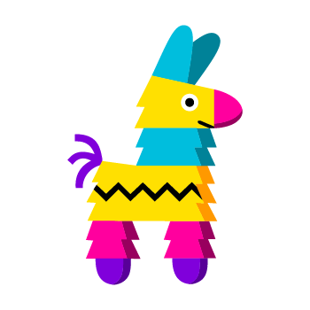

IPFS & PINATA
IPFS or InterPlanetary File System is a protocol, hypermedia and file sharing peer-to-peer network for storing and sharing data in a distributed file system.
IPFS uses content-addressing to uniquely identify each file in a global namespace connecting IPFS hosts
Pinata is an IPFS pinning service that makes IPFS easy for creators.
It help creators get their original content on IPFS through our easy-to-use web app. Once it's uploaded through Pinata, it's automatically pinned to IPFS and gets a unique CID.

Slide 6
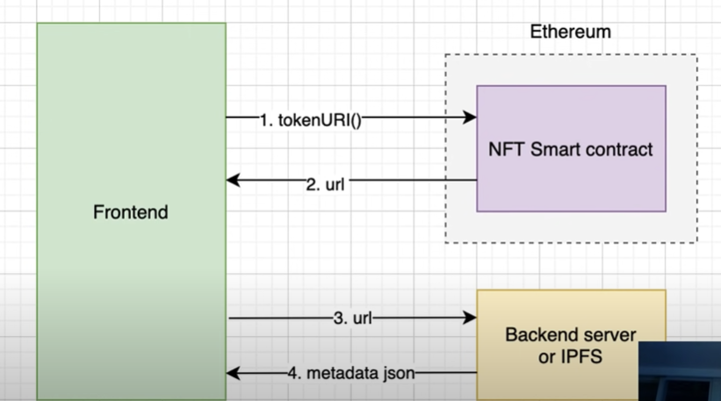

Slide 7
GOERLI TESTNET OF ETHEREUM
Goerli is a testnet, a decentralized computing network who’s ledger is separate from the main Ethereum ledger, so transactions do not cross over between the two.
It runs on a different consensus system, proof of authority, rather than the Ethereum mainnet proof of stake (PoS).
Goerli is one of Ethereum's most popular testnets and is used by web3 application developers to test their applications before launching them on the Ethereum Mainnet.

Slide 8
Thank You!!

